Slide 1
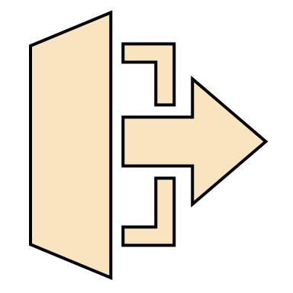
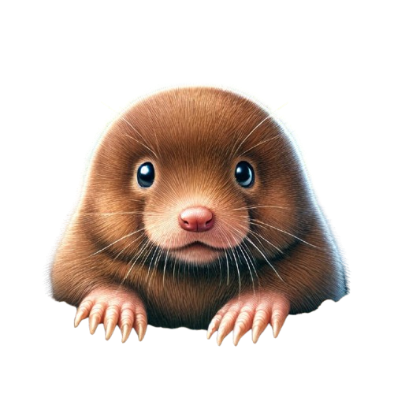
START
SETTINGS
LEADERBOARD

Slide 2


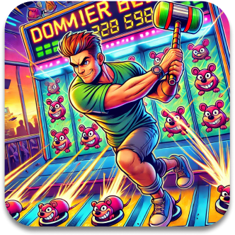
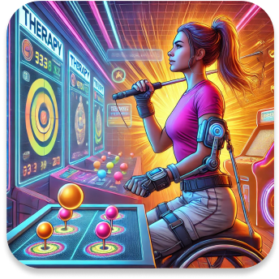
MODE SELECT
Beginner
Intermediate
Advanced
Accessibility
This mode is made for first time players as well as young students. Targets are easier to whack; disappear slower and appear larger on screen.
This is the standard level of difficulty. Moles pop up and down quickly, but you will receive more points.
Advanced is tailored for players who desire the highest level of challenge and want to top the leaderboards.
Accessibility mode supports a variety of augmentative input devices. Targets are large, and additional visual and audio elements guide players.

Slide 3
MODE SELECT
Beginner
Intermediate
Advanced
Accessibility
This mode is made for first time players as well as young students. Targets are easier to whack; disappear slower and appear larger on screen.
This is the standard level of difficulty. Moles pop up and down quickly, but you will receive more points.
Advanced is tailored for players who desire the highest level of challenge and want to top the leaderboards.
Accessibility mode supports a variety of augmentative input devices. Targets are large, and additional visual and audio elements guide players.
NEXT

Slide 4
MODE SELECT
Beginner
Intermediate
Advanced
Accessibility
This mode is made for first time players as well as young students. Targets are easier to whack; disappear slower and appear larger on screen.
This is the standard level of difficulty. Moles pop up and down quickly, but you will receive more points.
Advanced is tailored for players who desire the highest level of challenge and want to top the leaderboards.
Accessibility mode supports a variety of augmentative input devices. Targets are large, and additional visual and audio elements guide players.
NEXT

Slide 5
MODE SELECT
Beginner
Intermediate
Advanced
Accessibility
This mode is made for first time players as well as young students. Targets are easier to whack; disappear slower and appear larger on screen.
This is the standard level of difficulty. Moles pop up and down quickly, but you will receive more points.
Advanced is tailored for players who desire the highest level of challenge and want to top the leaderboards.
Accessibility mode supports a variety of augmentative input devices. Targets are large, and additional visual and audio elements guide players.
NEXT

Slide 6
MODE SELECT
Beginner
Intermediate
Advanced
Accessibility
This mode is made for first time players as well as young students. Targets are easier to whack; disappear slower and appear larger on screen.
This is the standard level of difficulty. Moles pop up and down quickly, but you will receive more points.
Advanced is tailored for players who desire the highest level of challenge and want to top the leaderboards.
Accessibility mode supports a variety of augmentative input devices. Targets are large, and additional visual and audio elements guide players.
NEXT

Slide 7




TUTORIAL
SEE!
WHACK!
REPEAT!
FIRST IDENTIFY THE MOLES POSITION
WACK THE MOLE AS QUICKLY AS YOU CAN
REPEAT UNTIL THE GAME CONCLUDES
THE FASTER YOU WHACK THE MORE POINTS YOU WILL RECEIVE

Slide 8
TIME : 00.00
SCORE : 00

Slide 9
SUMMARY
YOUR PERFORMANCE
FITTS LAW
SCORE – 0
MISSES – 0
SCORE/SEC – 0
DIFFICULTY - BEGINNER
TIME
SPEED
​PREDICTED -​
ACTUAL -
​PREDICTED -​
ACTUAL -
VIEW MORE
Leaderboard
Play Again

Slide 10
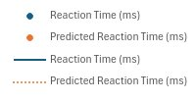
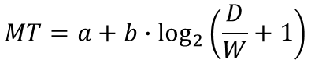
FITTS’ LAW
$$MT=a+b∙\log_{2}\left(\frac{D}{W}+1\right)$$
MT is the average time
a, b are constants
D is the distance to the target
W is the width of the target
This equation is based off the widely adopted Shannon formulation of Fitts' Law as proposed in 1992.
Fitts' Law is used to predict human movement. We can use the ratio between the distance to the target and the width of the target to calculate the average time to complete a movement.
Back

Slide 11

.
SETTINGS
ACCESSIBILITY
VOLUME
GRAPHICS
SOUND EFFECTS
MASTER
MOTION BLUR
ALT TEXT
EFFECTS
HIGH CONTRAST
QUALITY
TEXT SIZE
100%
MUSIC
LOW
SEE MORE
DEPTH OF FIELD
Back
Save

Slide 12
.
SETTINGS
ACCESSIBILITY
SOUND EFFECTS
COLOUR BLIND
DEFAULT
TEXT TO SPEECH
ALT TEXT
MOLE COLOUR
CAPTIONS
TEXT SIZE
100%
CONTRAST COLOUR
Back
Save

Slide 13
\
LEADERBOARD
PLAYER 01 ---------------
PLAYER 02 ---------------
PLAYER 03 ---------------
PLAYER 04 ---------------
PLAYER 05 ---------------
PLAYER 06 ---------------
PLAYER 07 ---------------
PLAYER 08 ---------------
PLAYER 09 ---------------
PLAYER 10 ---------------
PLAYER 11 ---------------
PLAYER 12 ---------------
Back
<<<<<
>>>>>

Slide 14
\
LEADERBOARD
PLAYER 13---------------
PLAYER 14 ---------------
PLAYER 15 ---------------
PLAYER 16 ---------------
PLAYER 17 ---------------
PLAYER 18 ---------------
PLAYER 19---------------
PLAYER 20 ---------------
PLAYER 21 ---------------
PLAYER 22 ---------------
PLAYER 23---------------
PLAYER 24---------------
Back
<<<<<
>>>>>

Slide 15
\
LEADERBOARD
PLAYER 01 ---------------
PLAYER 02 ---------------
PLAYER 03 ---------------
PLAYER 04 ---------------
PLAYER 05 ---------------
PLAYER 06 ---------------
PLAYER 07 ---------------
PLAYER 08 ---------------
PLAYER 09 ---------------
PLAYER 10 ---------------
PLAYER 11 ---------------
PLAYER 12 ---------------
Back
<<<<<
>>>>>

Slide 16
\
LEADERBOARD
PLAYER 13---------------
PLAYER 14 ---------------
PLAYER 15 ---------------
PLAYER 16 ---------------
PLAYER 17 ---------------
PLAYER 18 ---------------
PLAYER 19---------------
PLAYER 20 ---------------
PLAYER 21 ---------------
PLAYER 22 ---------------
PLAYER 23---------------
PLAYER 24---------------
Back
<<<<<
>>>>>

Slide 17



LEADERBOARD
LOCAL
PLAYER 01 ---------------
PLAYER 02 ---------------
PLAYER 03 ---------------
PLAYER 04 ---------------
PLAYER 05 ---------------
PLAYER 06 ---------------
PLAYER 07 ---------------
PLAYER 08 ---------------
PLAYER 09 ---------------
PLAYER 10 ---------------
PLAYER 11 ---------------
PLAYER 12 ---------------
NATIONAL
GLOBAL
BACK
<<<<<
>>>>>

Slide 18
LEADERBOARD
LOCAL
PLAYER 13 ---------------
PLAYER 14 ---------------
PLAYER 15 ---------------
PLAYER 16 ---------------
PLAYER 17 ---------------
PLAYER 18 ---------------
PLAYER 19 ---------------
PLAYER 20 ---------------
PLAYER 21 ---------------
PLAYER 22 ---------------
PLAYER 23 ---------------
PLAYER 24 ---------------
NATIONAL
GLOBAL
BACK
<<<<<
>>>>>

Slide 19
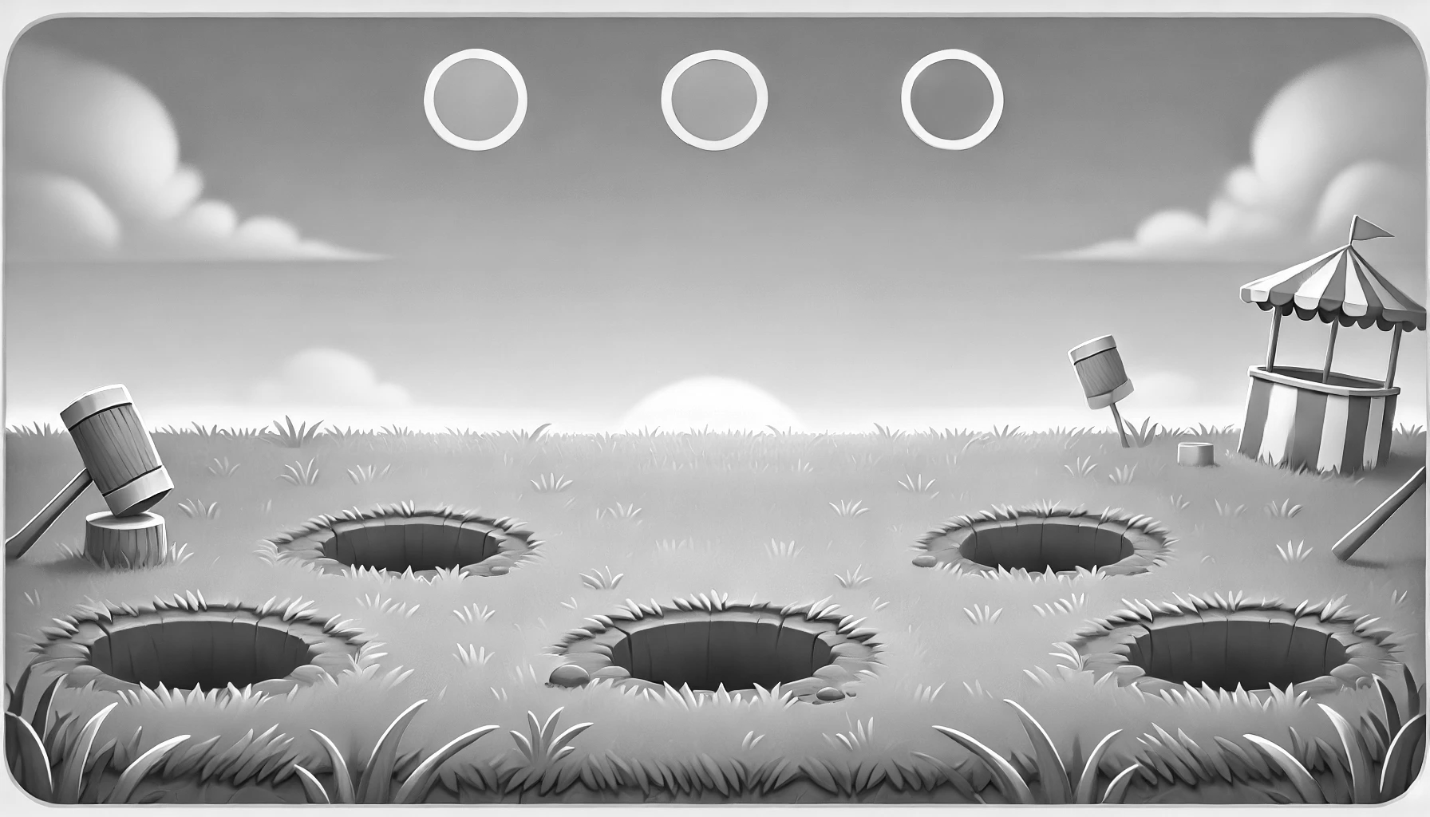


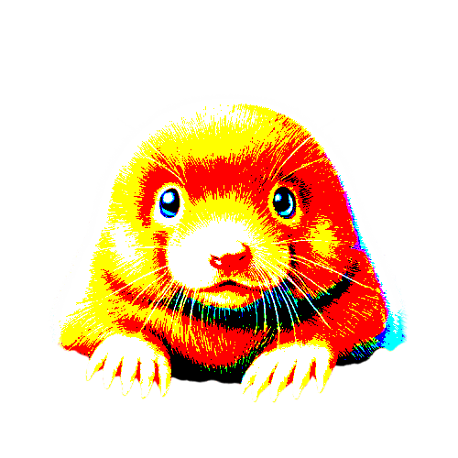
PLAY
SETTINGS
LEADERBOARD

Slide 20
SINGLE PLAYER
MULTIPLAYER
LOCAL
BACK

Slide 21
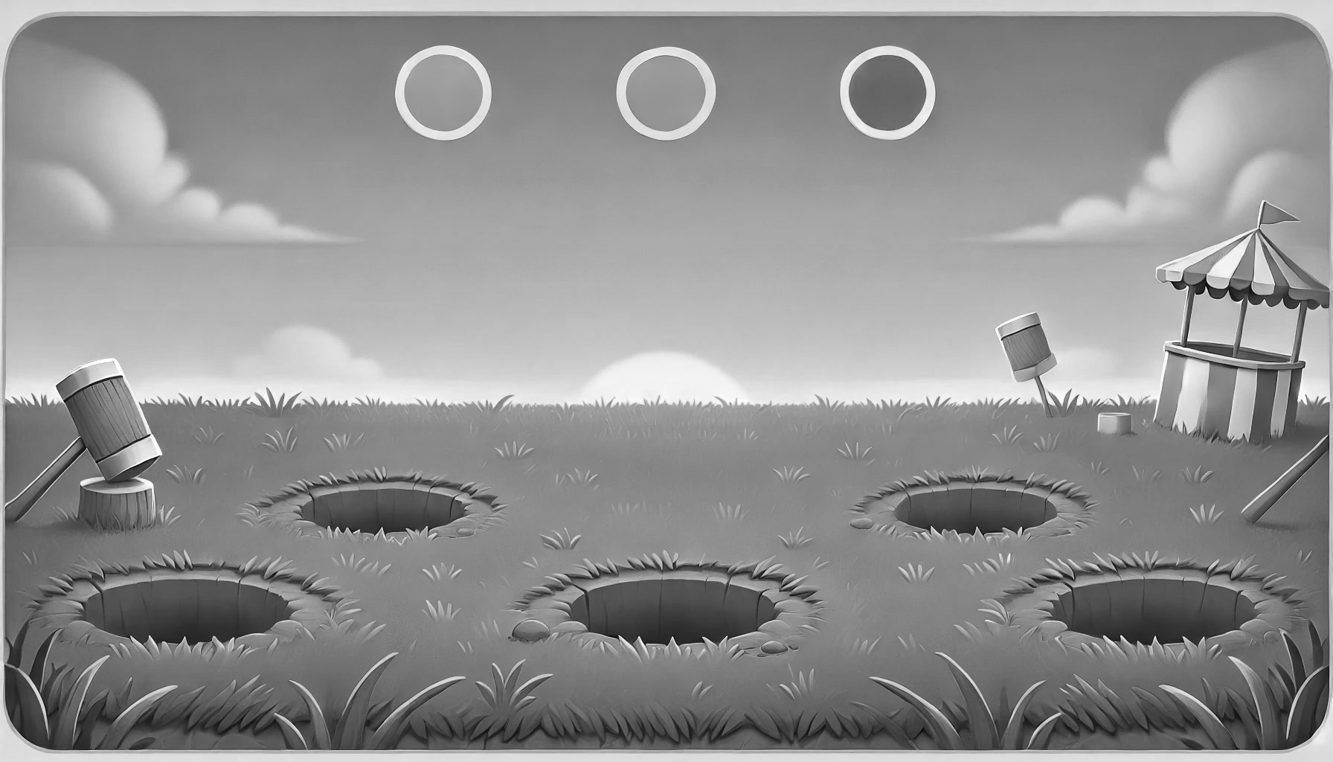




.
TUTORIAL
SEE!
WACK!
REPEAT!
FIRST IDENTIFY THE MOLES POSITION
WACK THE MOLE AS QUICKLY AS YOU CAN
REPEAT UNTIL THE GAME CONCLUDES
THE FASTER YOU WHACK THE MORE POINTS YOU WILL RECEIVE

Slide 22

TIME: 00.00
SCORE: 0

Slide 23
SUMMARY
YOUR PERFORMANCE
FITTS LAW
SCORE – 0
MISSES – 0
SCORE/SEC – 0
DIFFICULTY - BEGINNER
TIME
SPEED
​PREDICTED -​
ACTUAL -
​PREDICTED -​
ACTUAL -
VIEW MORE
Leaderboards
Play Again

Slide 24
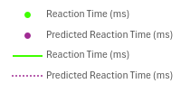
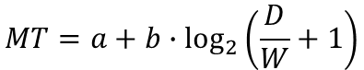
GRAPH
FITTS' LAW
$$MT=a+b∙\log_{2}\left(\frac{D}{W}+1\right)$$
MT is the average time
a, b are constants
D is the distance to the target
W is the width of the target
This is Shannon's interpretation of Fitts' Law.
Fitts' Law is used to predict human movement. We can use the ratio between the distance to the target and the width of the target to calculate the average time to complete a movement.
Back

Slide 25
.
SETTINGS
ACCESSIBILITY
VOLUME
GRAPHICS
SOUND EFFECTS
MASTER
MOTION BLUR
ALT TEXT
EFFECTS
HIGH CONTRAST
QUALITY
TEXT SIZE
100%
MUSIC
LOW
SEE MORE
DEPTH OF FIELD
BACK
SAVE

Slide 26
.
SETTINGS
ACCESSIBILITY
SOUND EFFECTS
COLOUR BLIND
DEFAULT
TEXT TO SPEECH
ALT TEXT
MOLE COLOUR
CAPTIONS
TEXT SIZE
100%
CONTRAST COLOUR
BACK
SAVE

Slide 27

\
LEADERBOARD
PLAYER 01 ---------------
PLAYER 02 ---------------
PLAYER 03 ---------------
PLAYER 04 ---------------
PLAYER 05 ---------------
PLAYER 06 ---------------
PLAYER 07 ---------------
PLAYER 08 ---------------
PLAYER 09 ---------------
PLAYER 10 ---------------
PLAYER 11 ---------------
PLAYER 12 ---------------
BACK
<<<<<
>>>>>

Slide 28
\
LEADERBOARD
PLAYER 13---------------
PLAYER 14 ---------------
PLAYER 15 ---------------
PLAYER 16 ---------------
PLAYER 17 ---------------
PLAYER 18 ---------------
PLAYER 19---------------
PLAYER 20 ---------------
PLAYER 21 ---------------
PLAYER 22 ---------------
PLAYER 23---------------
PLAYER 24---------------
BACK
<<<<<
>>>>>

Slide 29
LEADERBOARD
LOCAL
PLAYER 01 ---------------
PLAYER 02 ---------------
PLAYER 03 ---------------
PLAYER 04 ---------------
PLAYER 05 ---------------
PLAYER 06 ---------------
PLAYER 07 ---------------
PLAYER 08 ---------------
PLAYER 09 ---------------
PLAYER 10 ---------------
PLAYER 11 ---------------
PLAYER 12 ---------------
NATIONAL
GLOBAL
BACK
<<<<<
>>>>>

Slide 30
LEADERBOARD
LOCAL
PLAYER 13 ---------------
PLAYER 14 ---------------
PLAYER 15 ---------------
PLAYER 16 ---------------
PLAYER 17 ---------------
PLAYER 18 ---------------
PLAYER 19 ---------------
PLAYER 20 ---------------
PLAYER 21 ---------------
PLAYER 22 ---------------
PLAYER 23 ---------------
PLAYER 24 ---------------
NATIONAL
GLOBAL
BACK
<<<<<
>>>>>

Slide 31

Username
Password
LOG IN
Or sign in with
CONTINUE AS GUEST

Slide 32
PLAY AGAIN
MAIN MENU
EXIT

Slide 33
PLAY AGAIN
MAIN MENU
EXIT

Slide 34
SUMMARY
YOUR PERFORMANCE
FITTS LAW
SCORE – 0
MISSES – 0
SCORE/SEC – 0
DIFFICULTY - BEGINNER
TIME
SPEED
​PREDICTED -​
ACTUAL -
​PREDICTED -​
ACTUAL -
VIEW MORE
NEXT

Slide 35
.
TUTORIAL
SEE!
WACK!
REPEAT!
FIRST IDENTIFY THE MOLES POSITION
SWIPE TO THE MOLE AND WACK AS QUICKLY AS YOU CAN
REPEAT UNTIL THE GAME CONCLUDES

Slide 36
SUMMARY
YOUR PERFORMANCE
FITTS LAW
SCORE – 0
MISSES – 0
SCORE/SEC – 0
DIFFICULTY - BEGINNER
TIME
SPEED
​PREDICTED -​
ACTUAL -
​PREDICTED -​
ACTUAL -
VIEW MORE

Slide 37
.
TUTORIAL
SEE!
WACK!
REPEAT!
FIRST IDENTIFY THE MOLES POSITION
SWIPE TO THE MOLE AND WACK AS QUICKLY AS YOU CAN
REPEAT UNTIL THE GAME CONCLUDES

Slide 38


QUICK TIP
IF YOU OUT PREFORM FITTS' LAWS PREDICTION YOU GET MORE POINTS!

Slide 39


SINGLE PLAYER
MULTIPLAYER
LOCAL
BACK

